Slide 1
Contact Management System
Name: Abdur Rahman
Id: 19-39902-1
Assignment Topic: Contact Management System
Course: PL-1(Lab)
Sec: G

Slide 2
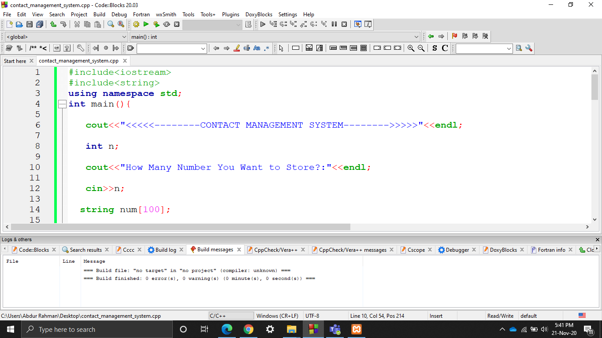
I am showing a simple program for Storing Phone Contacts. The user will input the number and name of contacts he wants to store in the phone book. The output is the list of the contacts

Slide 3
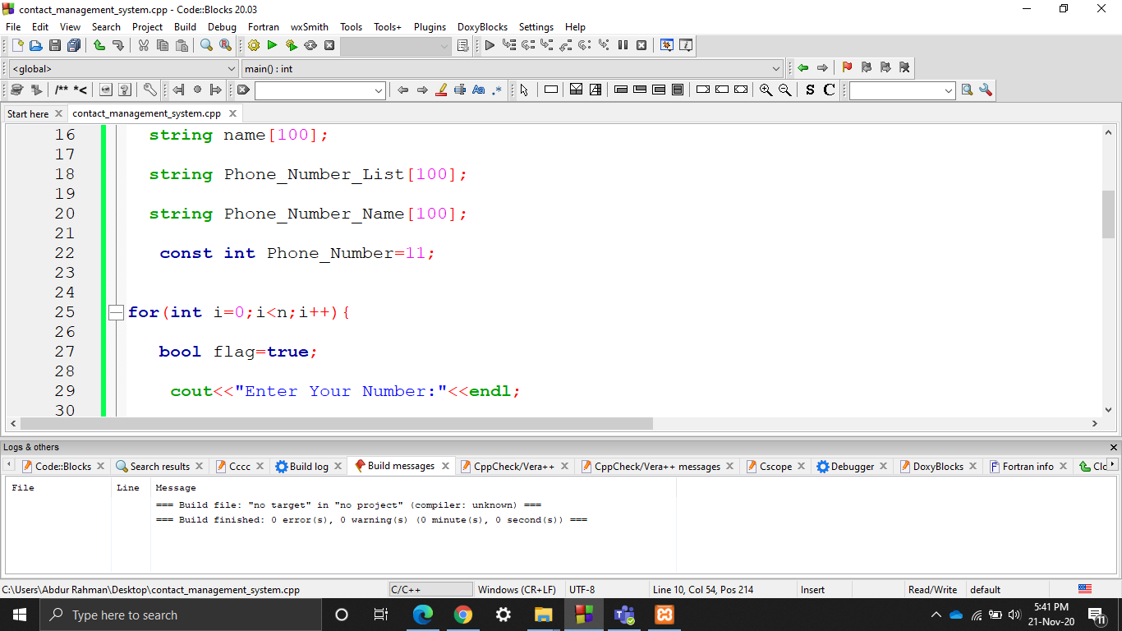
take string type array variable Using For Loop

Slide 4
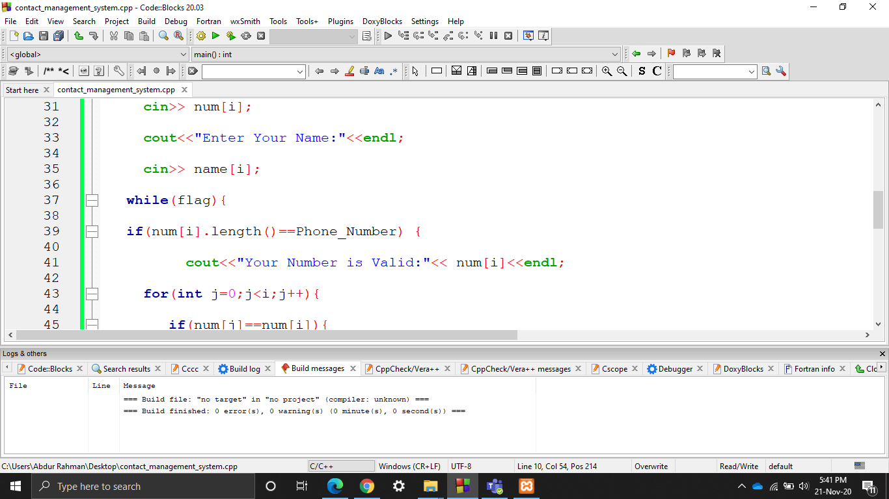
User input num User input name check any duplicate number using for loop

Slide 5
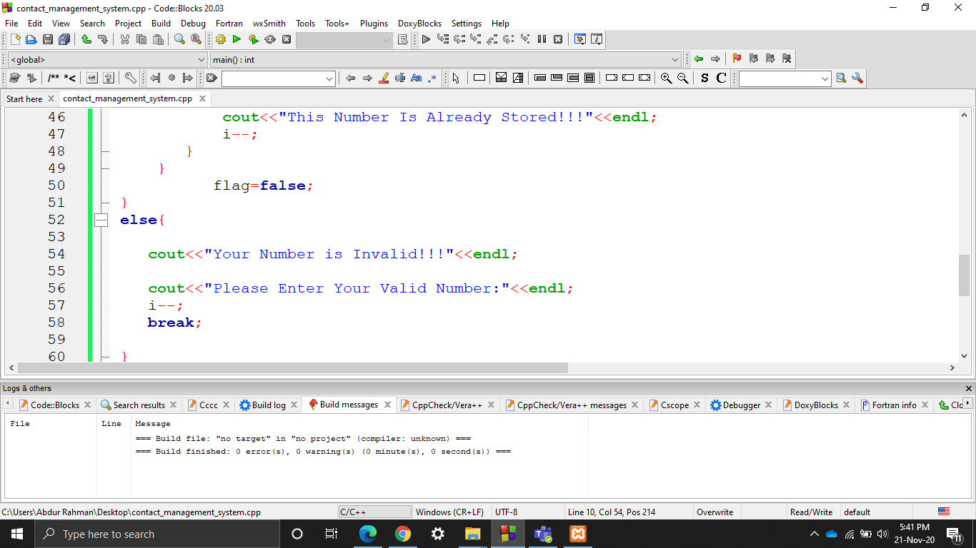
For loop check User Number is Valid or Invalid

Slide 6
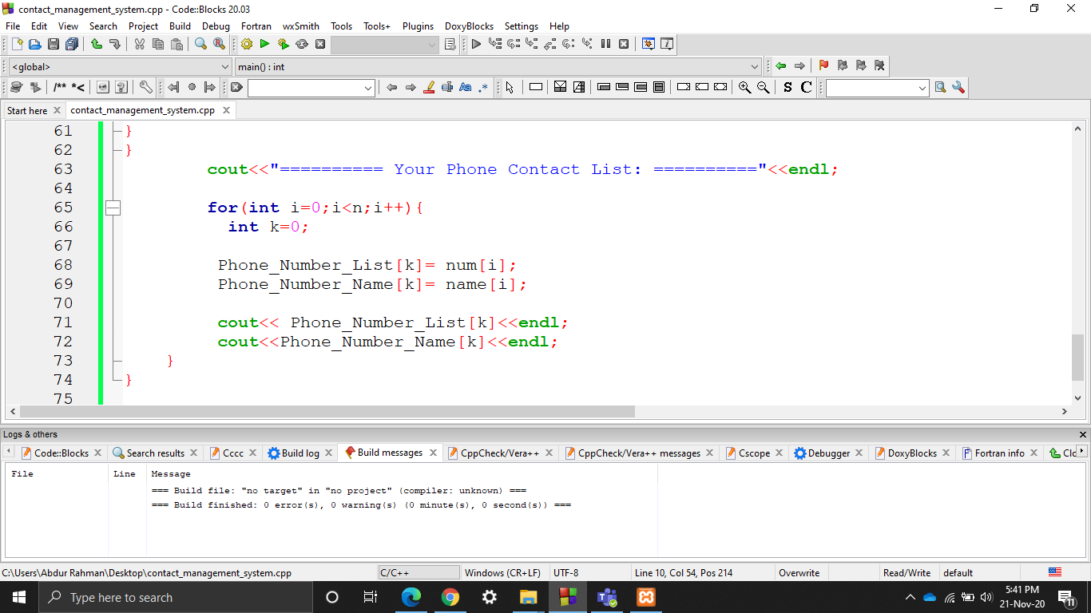
Using Loop for showing contact list

Slide 7
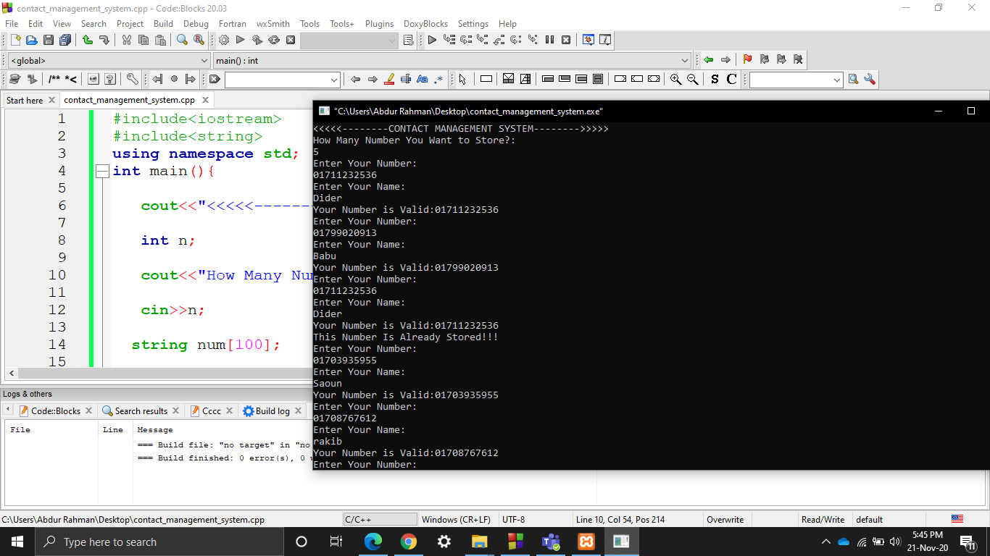
Program output

Slide 8
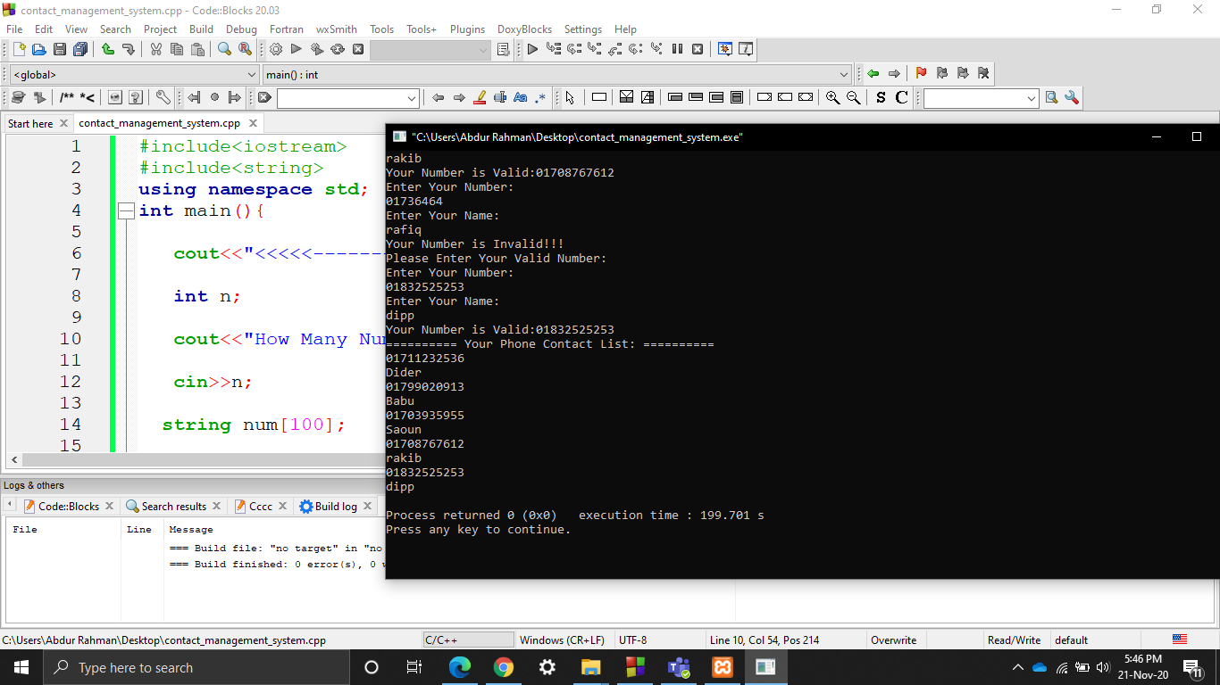
Program output for showing full contact list

